Slide 1
ECONOMICS PROJECT
Trends of supply of Money and its Impact
Group 9

Slide 2
Objectives :
To understand the role of money in Indian economy, and the different aspects of demand and supply of money.
To explore the realms of inflation and its different frontiers.
To delve into concepts like wage price spiral, hyperinflation and inflationary gap.

Slide 3
Meaning of “Money Supply ”:
The supply of money means the total stock of money (paper notes, coins and demand deposits of bank) in circulation which is held by the public at any particular point of time.
Briefly,money supply is the stock of money in circulation on a specific day. Thus two components of money supply are
(i) currency (Paper notes and coins)
(ii) Demand deposits of commercial banks.

Slide 4
Again it needs to be noted that (like difference between stock and supply of a commodity) total stock of money is different from total supply of money.
Supply of money is only that part of total stock of money which is held by the public at a particular point of time. In other words, money held by its users (and not producers) in spendable form at a point of time is termed as money supply.
The stock of money held by government and the banking system are not included because they are suppliers or producers of money and cash balances held by them are not in actual circulation. In short, money supply includes currency held by public and net demand deposits in banks.

Slide 5
Supply of Money(In Earlier times)
Earlier money was in form of coins, composed of gold , silver and copper etc.
Value of the coins was based on the value of metals they contained.
A currency issued by the government is called a fiduciary issue( based on trust and confidence)

Slide 6
Supply of Money(Now) :
Modern form of money is simply pieces of paper or numbers in a ledger.
System of paper money was introduced based on the gold standard or silver standard or some combination of the two , to ensure people’s faith in the system.

Slide 7
Sources of Money Supply in India :
(i) Government (which Issues one-rupee notes and all other coins)
(ii) RBI (which issues paper currency) , which is main source.
(iii) commercial banks (which create credit on the basis of demand deposits).

Slide 8
Models for Money Supply :
In India, Reserve Bank of India uses four alternative measures of money supply called M1, M2, M3 and M4. Each measure is briefly explained below :
(i) M1 = C + DD + OD. Here C denotes currency (paper notes and coins) held by public, DD stands for demand deposits in banks and OD stands for other deposits in RBI. Demand deposits are deposits which can be withdrawn at any time by the account holders. Current account deposits are included in demand deposits.

Slide 9
(ii) M2 = M1 (detailed above) + saving deposits with Post Office Saving Banks
(iii) M3= M1 + Net Time-deposits of Banks
(iv) M4 = M3 + Total deposits with Post Office Saving Organisation (excluding NSC)

Slide 10
Factors affecting Money Supply :
Money Supply is affected mainly by two factors viz. Monetary base and Money Multiplier.
Monetary Base: As the reserve money changes, money supply also changes in the same direction. This means if there is more of reserve money in the system, money supply would increase and vice versa. Most of the changes in the money supply are due to changes in the high powered money.
Money Multiplier: Money Multiplier is the ratio of the Narrow Money (M1) or the Broad Money (M3) to Reserve Money. Where m is the money multiplier.

Slide 11
The Supply of Money in India is regulated by
Reserve Bank of India
Since April 1935

Slide 12
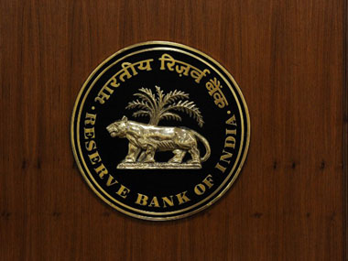
Reserve Bank Of India:

Slide 13
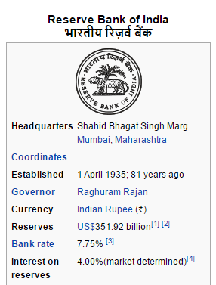

Slide 14
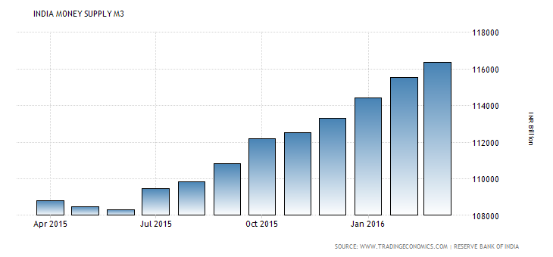

Slide 15
RBI’s role in money supply’s role in money supply :
The Reserve Bank of India is India's central banking institution, which controls the monetary policy of the Indian rupee. It commenced its operations on 1 April 1935 during the British Rule in accordance with the provisions of the Reserve Bank of India Act, 1934.
The institution is also the regulator and supervisor of the financial system and prescribes broad parameters of banking operations within which the country's banking and financial system functions.
The RBI controls the monetary supply, monitors economic indicators like the gross domestic product and has to decide the design of the rupee bank notes as well as coins.

Slide 16
How money is supplied and managed by RBI :
The RBI issues and exchanges currency notes and coins and destroys the same when they are not fit for circulation. The objectives are to issue bank notes and giving public adequate supply of the same, to maintain the currency and credit system of the country to utilize it in its best advantage, and to maintain the reserves.
The RBI is also a banker to the government and performs merchant banking function for the central and the state governments. It also acts as their banker.

Slide 17
Why RBI is the controlling factor?
RBI is separate body for taking action. This bank is authority. This bank can only be controlled by Finance ministry. Finance ministry can advise bank in many matters.
RBI changes rate described above and control inflation.
Rate of lending and borrowing are main weapons to control money flow in system. If rates of lending and borrowing increased then money from system will automatically goes out of system.
Cash reserve ratio is increased then money will go to RBI and not rest in system. This extra money in system is absorbed and inflation is cooled down. This is principle of controlling inflation.

Slide 18
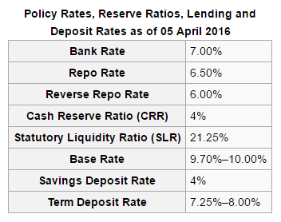
Current Rates :

Slide 19
CRR
CRR - CRR means Cash Reserve Ratio. Banks in India are required to hold a certain proportion of their deposits in the form of cash. However, actually Banks don’t hold these as cash with themselves, but deposit such case with Reserve Bank of India (RBI) / currency chests, which is considered as equivalent to holding cash with RBI. This minimum ratio (that is the part of the total deposits to be held as cash) is stipulated by the RBI and is known as the CRR or Cash Reserve Ratio. Thus, When a bank’s deposits increases by Rs100, and if the cash reserve ratio is 6%, the banks will have to hold additional Rs 6 with RBI and Bank will be able to use only Rs 94 for investments and lending / credit purpose.

Slide 20
Therefore, higher the ratio (i.e. CRR), the lower is the amount that banks will be able to use for lending and investment. This power of RBI to reduce the lendable amount by increasing the CRR, makes it an instrument in the hands of a central bank through which it can control the amount that banks lend. Thus, it is a tool used by RBI to control liquidity in the banking system.

Slide 21
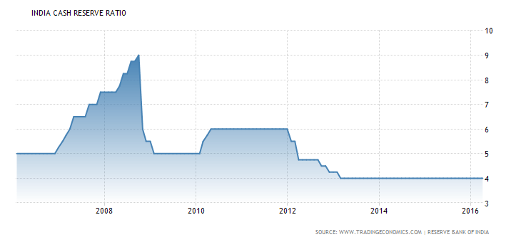

Slide 22
SLR
SLR - SLR stands for Statutory Liquidity Ratio. This term is used by bankers and indicates the minimum percentage of deposits that the bank has to maintain in form of gold, cash or other approved securities. Thus, we can say that it is ratio of cash and some other approved securities to liabilities (deposits) It regulates the credit growth in India.
SRR(statutory reserve requirement):- it is the amount of money set aside by banks to be placed in their Statutory Reserve Accounts with BNM(bank negara malaysia) with zero interest.

Slide 23
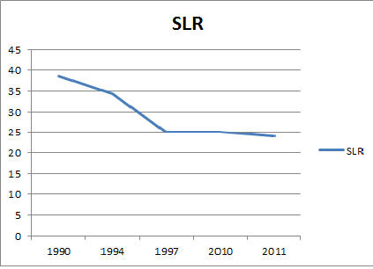

Slide 24
Repo and reverse repo :
Repo rate and reverse repo rate -
Rate at which banks take money from RBI and Banks give money to RBI. If any bank in India needs money for demand of loan,the bank can take money from RBI. But bank have to pay interest rate for this money to RBI. This rate is repo rate.
This has influence on money flow in India.
When banks have more money the bank gives money to RBI. This money is taken by RBI at a certain rate. This rate is reverse repo rate.
Change in both the rates affects the money supply in the country.

Slide 25
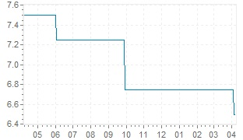
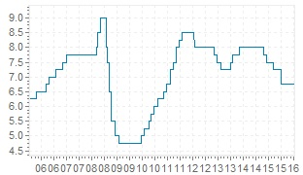
Change in the RBI repo rates overtime.
(India cuts its repo rate to the lowest in over 5 years)
Interest rates last year long term graph

Slide 26
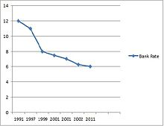
Reverse repo rate :

Slide 27
Latest changes in the rates:
change date percentage
april 05 2016 6.500 %
september 29 2015 6.750 %
june 02 2015 7.250 %
march 04 2015 7.500 %
january 15 2015 7.750 %
january 28 2014 8.000 %
october 29 2013 7.750 %
september 20 2013 7.500 %
may 03 2013 7.250 %
march 19 2013 7.500 %

Slide 28
Three measures of Money Supply in India
Some of the important measures of money supply in India are as follow:
Currency with the public which includes notes and coins of all denominations in circulation excluding cash on hand with banks:
Demand deposits with commercial and cooperative banks, excluding inter-bank deposits; and
‘Other deposits’ with RBI which include current deposits of foreign central banks, financial institutions and quasi-financial institutions such as IDBI, IFCI, etc., other than of banks, IMF, IBRD, etc. The RBI characterizes as narrow money.

Slide 29
Major Recommendations of RBI’s Working Group on Money Supply :
Sectorization of Indian Economy in four major sectors
Households
non-financial commercial
general government and
financial corporations comprising
the banking sector consisting of the Reserve Bank of India and the banking system in India and
other financial corporations comprising
development financial institutions including term-lending and refinancing institutions
insurance companies,

Slide 30
mutual funds and
non-banking financial companies accepting public deposits. In addition, non-residents would constitute the ‘rest of the world sector’ which can have transactions with any of the domestic sectors.
In addition, non-residents would constitute the ‘rest of the world sector’ which can have transactions with any of the domestic sectors.

Slide 31
Savings deposits of post offices are not a part of money supply because they do not serve as medium of exchange due to lack of cheque facility.
Similarly, fixed deposits in commercial banks are not counted as money.
Therefore, M1 and M2 may be treated as measures of narrow money whereas M3 and M4 as measures of broad money.
In practice, M1 is widely used as measure of money supply which is also called aggregate monetary resources of the society. All the above four measures represent different degrees of liquidity, with M4 being the most liquid and M4 is being the least liquid. It may be noted that liquidity means ability to convert an asset into money quickly and without loss of value.

Slide 32
Demand for money :
Keyes has identified three motives to hold money
Transaction motive
Consumers need money to meet their day to day needs.
Producers need money to make investments.
Precautionary motive
To cover for unforeseen events such as sickness,accidents and losses , money is kept as precaution for contingency.

Slide 33
Money does not have inherent value it is valuable because
Medium Of Exchange.
The most convenient medium of exchange
All the things which have utility are available in exchange of money.
Under the barter system where goods are exchanged for goods dual coincidence of wants is the basis for exchange.
Measure Of Value
Provides a common denominator to all types of goods and services.
Store of Value
Can be saved for future with the convenience , whereas other goods can be saved for a limited time period only.

Slide 34
-Speculative motive
For making gains from speculations on future value of bonds and securities.
Money may be demanded as a flow (transaction motive) as a stock (precautionary motive).
Money as a flow is that which is in circulation.
Total money supply at any point of time consists of money in circulation as well as in stock (in various forms of savings and deposits.)

Slide 35
According to monetary policies:
Inflation- excess demand..too much supply of money.. price rises...value of money goes down...CRR inc, BR(bank rate) inc,selling of securities
According to fiscal policies: deficient demand--(depression) CRR dec, BR dec,purchase of securities,money supply rate is less than increse in prices of different goods.

Slide 36
RBI Statement for supply of money 2016
Click on the below hyperlink:
PR2300300316_MS.xls

Slide 37
Thank You
Rupam Jogal (1401003)
Rushita Thakkar (1401004)
Charmi Kalani (1401067)
Ishika Agarwal (1401069)
Twinkle Vaghela (1401106)
Nivedita Rao (1401100)
Himani Patel (1401111)
Honey Gadhiya (1401112)

